Slide 1
2020 OHDSI Symposium Tutorial OMOP Cancer Extension

Slide 2
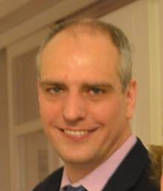





Instructors
Christian Reich | Rimma Belenkaya | Asieh Golozar | Robert Miller
Michael Gurley | Anastasios Siapos

Slide 3
Agenda
1
Introduction: Motivation, overview of the Cancer Module
Exercise: Create a database with Cancer Module
Querying the Cancer Module
Exercise: ATLAS and SQL queries
2
3a
Step-by-step implementation of Cancer Module
Exercise: ETL your own database from NAACCR data
3b
Chemo Regimen: Detect from drug administrations
Exercise: Query regimens and cycles

Slide 4
Inside each block
30 min introduction – listen carefully
45 min exercise in learning group
Ask questions to teacher assistant in your group
45 min review
30 minutes break before next block

Slide 5
OHDSI-in-a-Box

Slide 6





OHDS-in-a-Box
Raw Lauren
PostgreSQL
CDM Lauren (EMPTY)
cdm
webapi
Atlas
Raw Synthea
WebTools
WebAPI
CDM Synthea
PGAdmin4
Tomcat
CDM Synpuf (100K)
Methods Library
WhiteRabbit
OHDSI R packages
Studio
Usagi

Slide 7
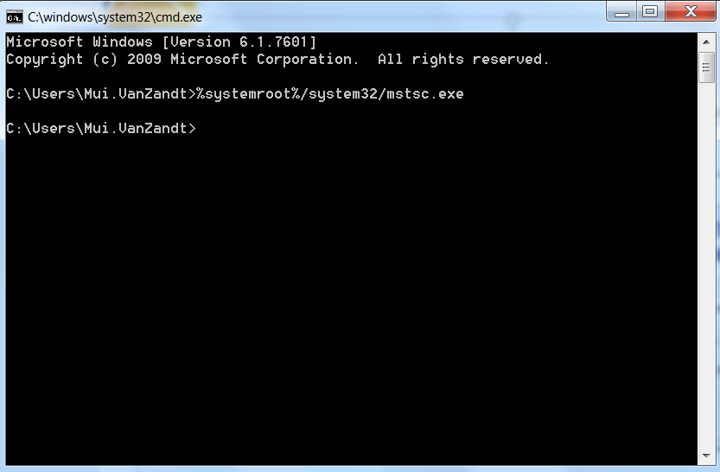
How to Sign into the Remote Desktop
From your command prompt, type %systemroot%/system32/mstsc.exe to launch Remote Desktop

Slide 8
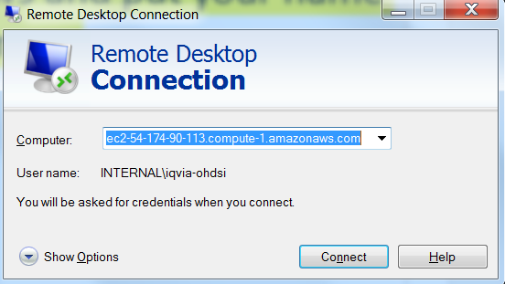
How to Sign into the Remote Desktop
Use the shortcut on the desktop named “Remote Desktop”
https://docs.google.com/spreadsheets/d/1x7-6J0NBkm1cRHna0N9tmLWvirpynLSwiZsBZY7FiIQ/edit?usp=sharing
Pick one of the rows and put your name on the second column
Take Column A from spreadsheet and copy into the “Computer” field

Slide 9
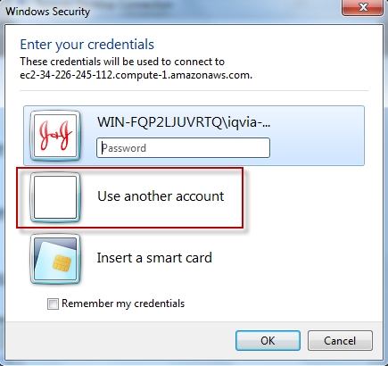
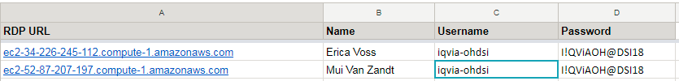
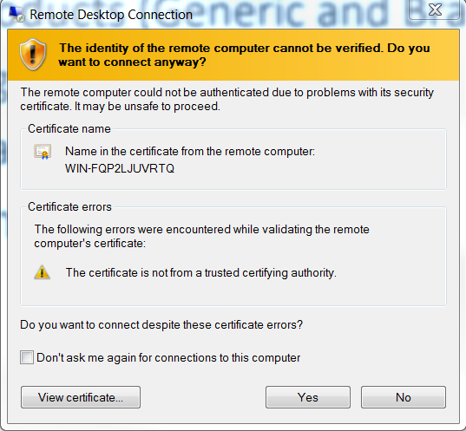
How to Sign into the Remote Desktop
Pick ‘Use Another Account’
Copy username from Column C
Copy password from Column D
If you get this page, select “Yes”

Slide 10

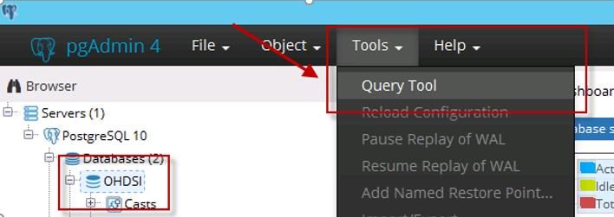
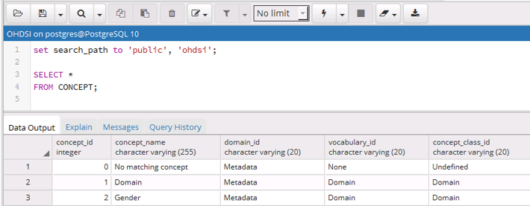
CDM Database:pgAdmin III New Server
Click on PGAdmin
Password: ohdsi
Select the Query Tool
Type set “search_path to 'ohdsi’;”

Slide 11
OMOP Cancer Extension Introduction

Slide 12
We have the OMOP CDM
OMOP covers all diseases
Cancer is a disease
=> What’s the problem?

Slide 13
Cancer needs a Lot more detail
“What is the overall survival for patients with non-metastatic carcinoma of the neck of bladder in remission after first line of gemcitabin-containing chemotherapy?“
Concept | Category
Carcinoma | Histology
Concept | Category
Carcinoma | Histology
Neck of bladder | Anatomical site
Non-metastatic disease | Tumor attribute
Disease in remission | Condition Episode
First line treatment | Treatment Episode
Chemotherapy regimen | Regimen
Gemcitabin | Component of regimen
Concept | Category
Carcinoma | Histology
Neck of bladder | Anatomical site
Non-metastatic disease | Tumor attribute
Disease in remission | Condition Episode
First line treatment | Treatment Episode
Chemotherapy regimen | Regimen
Concept | Category
Carcinoma | Histology
Neck of bladder | Anatomical site
Non-metastatic disease | Tumor attribute
Disease in remission | Condition Episode
First line treatment | Treatment Episode
Concept | Category
Carcinoma | Histology
Neck of bladder | Anatomical site
Non-metastatic disease | Tumor attribute
Disease in remission | Condition Episode
Concept | Category
Carcinoma | Histology
Neck of bladder | Anatomical site
Non-metastatic disease | Tumor attribute
Concept | Category
Carcinoma | Histology
Neck of bladder | Anatomical site

Slide 14
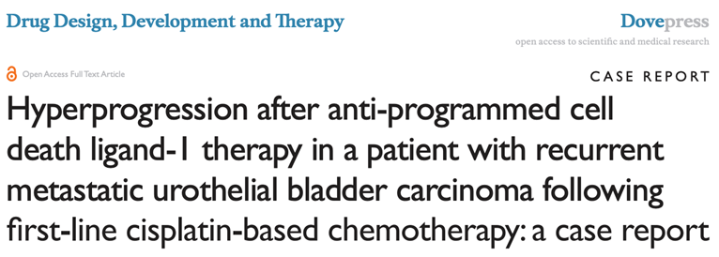
Typical Course of Cancer Patient

Slide 15
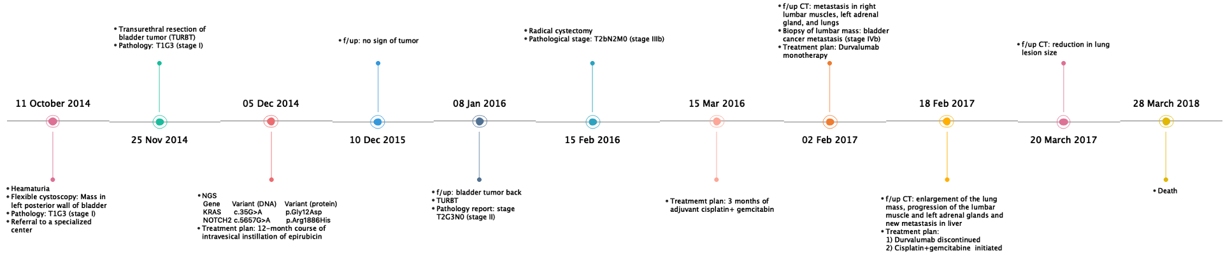
How does Cancer manifest in the data?
Event
Bladder Cancer
Event
Event
Event

Slide 16
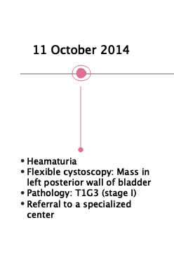
Typical Course of Cancer Patient
Initial Event

Slide 17
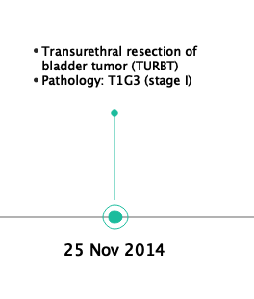
Typical Course of Cancer Patient
Treatment

Slide 18
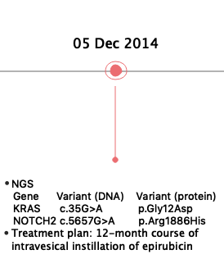
Typical Course of Cancer Patient
Genomic testing and treatment

Slide 19
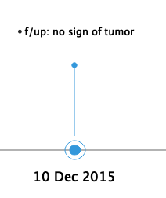
Typical Course of Cancer Patient

Slide 20
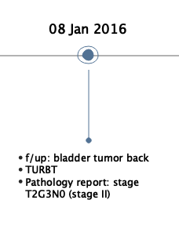
Typical Course of Cancer Patient
Relaps

Slide 21
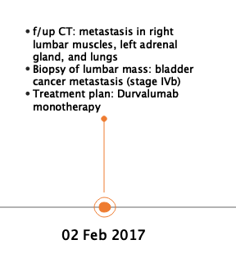
Typical Course of Cancer Patient
Progression

Slide 22
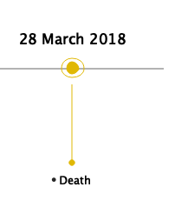
Typical Course of Cancer Patient

Slide 23
We need a model
Format
Vocabularies
Disease Details
Course of Disease
Treatment
Representing

Slide 24
Introduction into OMOP Cancer Extension
Rimma’s picture

Slide 25
Components of Exension
Cancer Diagnosis Model
Cancer Treatment Model
Cancer Episode Model
1
2
3
Notes:
The extension has been tested in EHR and Cancer Registry data against a number of typical use cases.

Slide 26
Cancer Diagnosis Model
1
Base Diagnosis
Topography + Histology
Diagnostic Modifiers
Topography
Staging/Grading
Histopattern
Biomarker
Margin
Metastasis
Dimension
Extension/Invasion
Base Diagnosis
Bladder Cancer
Topography
Posterior wall
Metastasis
Left adrenal gland
Stage
T2bN2M0
Genomic Variant
KRAS c.35G>A

Slide 27
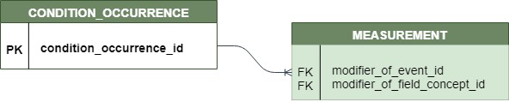
Base Diagnosis + Vocabularies
1
In CONDITION_OCCURRENCE, Domain “Condition”
Vocabulary: SNOMED, ICDO3, ICDO3 combined by OMOP
Cancer Diagnosis concepts = combination of
Morphology Topography
(histological type of tumor) (organ or anatomical location)
SNOMED
SNOMED
SNOMED
Neoplasm, malignant
Primary malignant neoplasm of bladder
Posterior wall of bladder
SNOMED
SNOMED
SNOMED
Neoplasm, malignant
Primary malignant neoplasm of posterior wall of urinary bladder
Structure of posterior wall of urinary bladder
ICDO
OMOP (combined from ICDO)
ICDO
Transitional cell carcinoma, NOS
Transitional cell carcinoma of posterior wall of bladder
Posterior wall of bladder

Slide 28
Diagnostic Modifiers + Vocabularies
1
In MEASUREMENT, Domain “Measurement”
Standard Modifier concepts = attributes of cancer
Defines prognosis and treatment
Standard Value concepts = {Negative, Positive, Equivocal, Strong, etc.)
Topography | More detail than ICDO | Cancer Modifier, adopted by OMOP from CAP and NAACCR
Histopattern | More detail than ICDO | Cancer Modifier, adopted by OMOP from CAP and NAACCR
Staging/Grading | Externally defined | NCIt, Cancer Modifier, adopted by OMOP from CAP and NAACCR
Extension/Invasion | Local tumor growth | Cancer Modifier, adopted by OMOP from CAP and NAACCR
Nodes | Growth into lymphatic system | Cancer Modifier, adopted by OMOP from CAP and NAACCR
Metastasis | Distant growth (except lymph nodes) | OMOP, adopted from CAP and NAACCR
Dimension | Tumor size | OMOP, adopted from CAP and NAACCR
Margin | Margin after surgery | OMOP, adopted from CAP and NAACCR
Biomarker | Genomic variants | HGNC, OMOP, adopted from CAP, CGI, CIViC, ClinVar, JAX, NAACCR, NCIt,

Slide 29
Connection Base Diagnosis-Modifier
1
Modifier
Base Diagnosis
Modifier
Modifier
Modifier

Slide 30
Learned: Cancer Diagnosis Model
1
Cancer Diagnosis =
Base Diagnosis + Diagnostic Modifiers
Base Diagnosis:
Histology + Anatomic Site
Diagnostic Modifiers
Topography
Staging/Grading
Histopattern
Biomarker
Margin
Metastasis
Dimension
Extension/Invasion
One-to-many connection between them

Slide 31
Components of Extension
Cancer diagnosis model
Cancer treatment model
Cancer episode model
1
2
3
Notes:
The extension has been tested in EHR and Cancer Registry data against a number of typical use cases.

Slide 32
Treatment Model
2
Composite Treatment
Individual Treatment
Chemotherapy Regimen
Gemcitabin-Cisplatin
Drug Exposure
Cisplatin
Drugs
Chemotherapy Cycle
Cycle 1
Drug Exposure
Gemcitabin
Radiation therapy
External beam radiotherapy
Individual radiotherapy
Proton treatment delivery; intermediate
Procedures
Surgical therapy
Transurethral resection of bladder neoplasm

Slide 33
Treatment Model
2
Composite Treatment
Individual Treatment
Chemotherapy Regimen
Gemcitabin-Cisplatin
Drug Exposure
Cisplatin
Drugs
Chemotherapy Cycle
Cycle 1
Drug Exposure
Gemcitabin
Episodes
Radiation therapy
External beam radiotherapy
Individual radiotherapy
Proton treatment delivery; intermediate
Procedures
Surgical therapy
Transurethral resection of bladder neoplasm

Slide 34
Individual Procedure Treatments Individual Drug Treatments
2
Standard OMOP
In DRUG_EXPOSURE, Domain “Drug”
In PROCEDURE_OCCURRENCE, Domain “Procedure”

Slide 35
Learned: Cancer Treatment Model
2
Treatment =
Composite (High) Level or Individual (Low) Level
High Level = Treatment Episode
Low Level = Standard OMOP

Slide 36
Components of Extension
Cancer diagnosis model
Cancer treatment model
Cancer Episode Model
1
2
3
Notes:
The extension has been tested in EHR and Cancer Registry data against a number of typical use cases.

Slide 37
Episode Model
3
What are Episodes? Continuous periods of disease or treatment that have distinct clinical meaning and are composed of multiple events, e.g.
• Progressive Disease Episode
• Treatment Regimen
Why do we need them? For analytical use cases, e.g.
• Overall and Progression-Free Survival (OS, PFS)
• Time to progression
• Response to treatment
How do we get them? Directly from source data (e.g. registries) or algorithmically derived

Slide 38
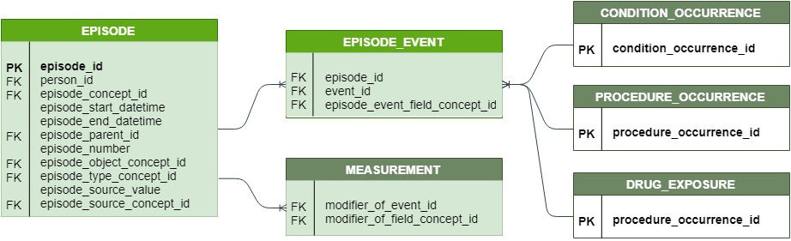
New table: EPISODE
3
Abstracted Episode
Timing
Nesting of Episodes
Episode chaining
Value of EAV

Slide 39
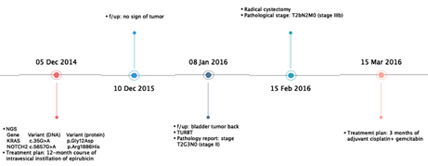
Episode Nesting
3
Overall Episode “Bladder Cancer”
Disease Episode Remission
Disease Episode Progression

Slide 40
Episode EAV = sentence
3
Remission
10-Dec-2015
8-Jan-2016
Bladder Cancer

Slide 41
Connection Episode–Events
3
Events
On-to-many connector
Diagnostic Modifiers

Slide 42
Episode Concepts and Rules
3
Concepts
Rules
Disease Episodes – Domain “Episode”
Overarching: “Cancer Episode”
Extent
“Confined Disease”
“Invasive Disease”
“Metastatic Disease”
“Hematologic Cancer”
Dynamic
“Remission”
“Partial Remission”
“Complete Remission”
“Stable Disease”
“Progression”
“Disease Recurrence”
Start with diagnosis, span everything
Start with evidence (Diagnostic Modifier)
End with start of next Extent Episode
Start at evidence (Diagnostic Modifier, Surgery)
End at next Treatment Episode or new evidence

Slide 43
Cont: Episode Concepts and Rules
3
Concepts
Rules
Surgery Treatment Episodes
“Cancer Surgery”
Other Treatment Episodes
“Cancer Radiotherapy”, “Cancer Drug Treatment”
Starts and ends the same day
According to rule set (see Block 3)

Slide 44
Episode Object Concepts
3
Actual diagnosis, procedures, drug regimens

Slide 45
Episode Chaining
3
Episode of the same category (Disease Extent, Disease Dynamics, Treatment) are numbered
Disease Episode #1 is the one defined by the first (initial) cancer diagnosis

Slide 46
Learned: Cancer Episode Model
3
Episodes are abstract high-level time intervals summarizing a number of events
There are Disease and Treatment Episodes (defined by the Episode Concept)
Condition, Procedure and Drug Domain concepts define the Episode Object
Episodes can be nested

Slide 47
Foundation

Slide 48




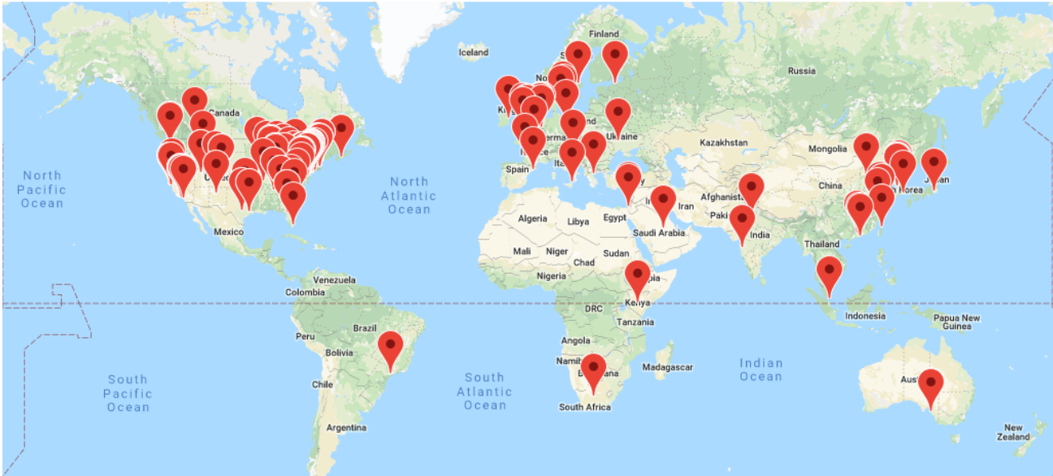


Opportunity for our team to embrace ‘Open Science’ and be part of something different
Ambulatory
Hospital
OHDSI Collaborators:
2,770 users
25 workgroups
18,700 posts on 3,250 topics
OHDSI Network:
>150+ databases
21 countries
2.1B patient records, 369M ex-US
http://ohdsi.org

Slide 49






OMOP to OHDSI
OHDSI
Columbia University
OMOP Investigators
The Observational Health Data Sciences and Informatics (OHDSI) program is a multi-stakeholder, interdisciplinary collaborative to create open-source solutions that bring out the value of observational health data through large-scale analytics
OHDSI has established an international network of researchers and observational health databases with a central coordinating centre housed at Columbia University
Public, open
Not pharma funded
International

Slide 50
History of OMOP/OHDSI
EHDEN Initiation (Europe)
Started under the Innovative Medicines Initiative (IMI) that will drive the adoption of the OMOP-CDM in Europe
FederNET Initiation (Korea)
First European Symposium
NMPA Adoption
Global Acceptance
OHDSI grows to >152 databases, 18 countries, 2.1B patient records, 369M ex-US
Regional chapters in US, Europe, China, South Korea + Asia-Pacific, Latin America
Offering regional symposia
OMOP Experiment #2/European OMOP
Focused on a subset of data (4 claims, 1 EHR) and 7 methods
Replicating experiment findings on European databases
Formation of China Chapter
To use data science and informatics methods to promote health and medical data research in China
Formation of Korea Chapter
Launch of OHDSI
OHDSI’s first face-to-face meeting at Columbia University
2011
2014
2016
2018
2020
2009
2013
2015
2017
2019
OMOP Experiment #1
FDAAA calls for establishing Risk Identification and Analysis System for drug surveillance
OMOP Experiment creates a framework for evaluating 14 methods of epidemiological designs
10 data sources, claims and EHRs, 200M+ lives
End of OMOP Experiment
Last of the OMOP Meetings present findings of empirical experiments
Artifacts include the OMOP CDM, vocabularies and validated methods for analyzing real world data
First OHDSI Symposium/Network Study Published
Community begins open source work under OHDSI brand
First global network study characterizing treatment pathways
First Hackathon at Columbia University
Formation of European Chapter
Led by the coordinating center at the Erasmus University Medical Center in Rotterdam
FDA Adoption
(FDA BEST Launch)
EMA Adoption
Formation of Australia, Japan and Singapore Chapters

Slide 51

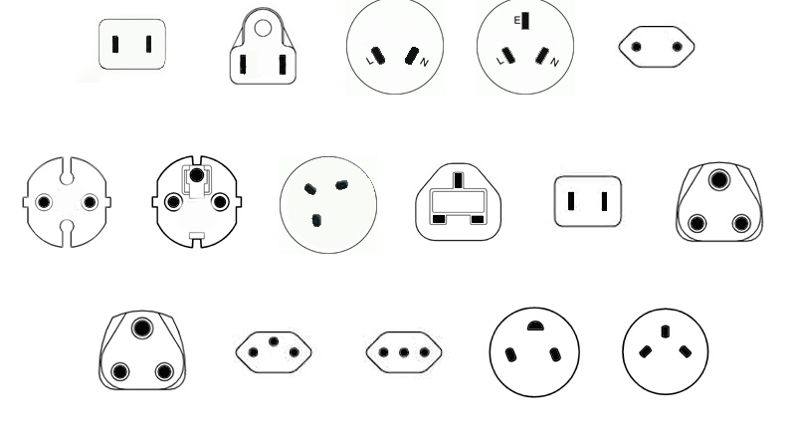
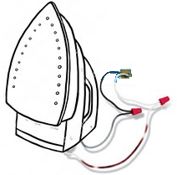
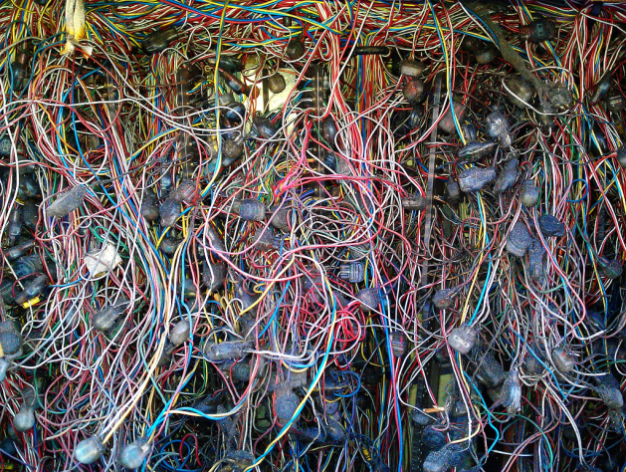
Current Approach: “One Study – One Script“
"What's the adherence to my drug in the data assets I own?"
Current solution:
Analytical method: Adherence to Drug
North America
Southeast Asia
China
Europe
UK
Japan
India
Application to data
Switzerland
Italy
So Africa
Israel
Not scalable
Not transparent
Expensive
Slow
Prohibitive to non-expert routine use
One SAS or R script for each study

Slide 52



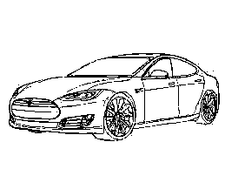
Solution: Data Standardization Enables Systematic Research
Adherence
Mortality
Source of Business
North America Southeast Asia China
Europe UK Japan India
So Africa Switzerland Italy Israel
Safety Signals
Standardized data

Slide 53


Analytics Can Be Remote
North America Southeast Asia China
Europe UK Japan India
So Africa Switzerland Italy Israel

Slide 54
Analytics Can Be Behind Firewall

Slide 55

Network Studies Networks of networks
EMR
EMR
EMR
University Medical Center
EMR
ISDN
Inpatient Hospital
Claims Asset
Coordinating
Center
Outpatient Hospital
Claims Asset
EMR Asset
Coordinating Center
Another Network
Network
Claims Asset
Claims Asset
Claims Asset
EMR Asset
EMR Asset
EMR Asset
EMR Asset

Slide 56
Source Codes, Concepts and Mapping to Standard Concepts

Slide 57
The Source for Source Codes
May come from international terminology or code system
SNOMED
1
May come from a country specific terminology or code system
Read, BDPM, ICD10CN, CVX
2
May be free text strings
Centimeter, Intravenous, Cigarette Smoker
3
May come from an EHR specific code system
Epic procedure codes: ‘L111’
4

Slide 58
Different Categories of Concepts
Non-standard Concepts
Standard Concepts
Classification
Concepts
Function
Unique representation of a source code
Function
Used for standardized analytics and by
OHDSI tools
Function
Used to perform hierarchical queries

Slide 59
Mapping Non-Standard Source concept_IDs to Standard concept_IDs
CONCEPT RELATIONSHIP
Non-standard Concepts
Standard Concepts

Slide 60
Mapping Source Codes to Standard Concept_IDs

Slide 61
Source Codes Mapping – Scenario 1
Scenario
Solution
Source code is available in an OHDSI supported Vocabulary
Use using the following condition to perform the mapping:
Where <source code> = CONCEPT.concept_code and <source vocabulary> = CONCEPT.vocabulary_id
Source code | Source vocabulary | Code description | CONCEPT.concept_id
61462000 | SNOMED | Malaria | 438067
A663D00 | Read | Zika Fever | 45489770
A92.3 | ICD10CN | West Nile Virus Infection | 1404276

Slide 62
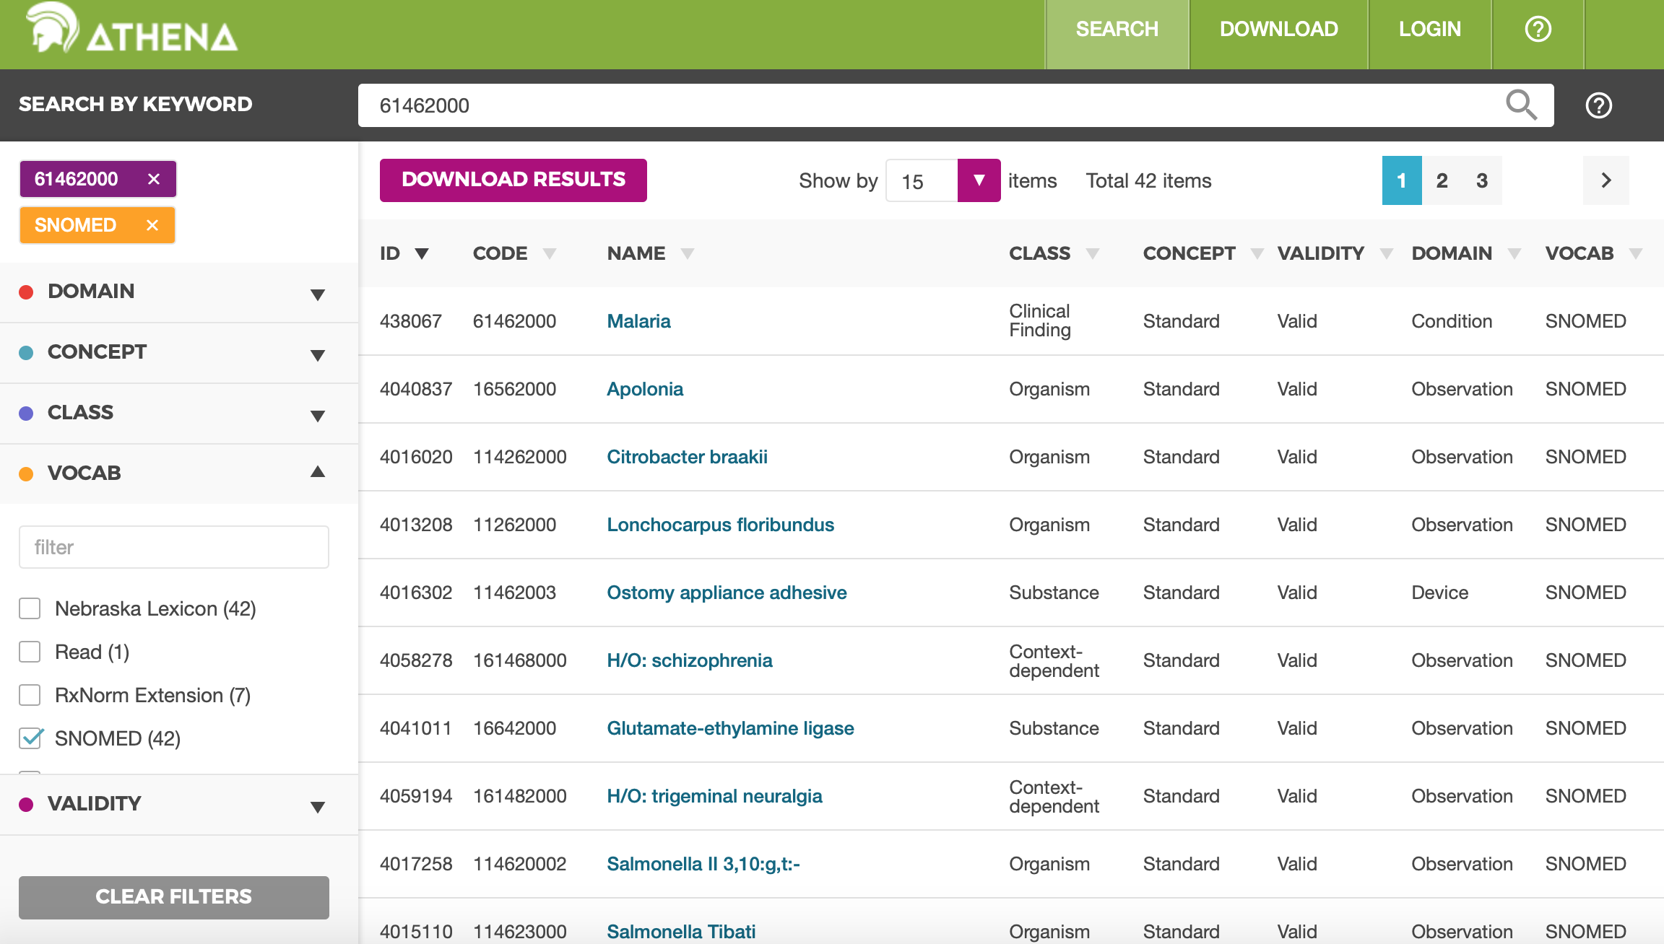

Slide 63
Source Codes Mapping – Scenario 1
Scenario
Solution
Source code is available in an OHDSI supported Vocabulary
Use using the following condition to perform the mapping:
Where <source code> = CONCEPT.concept_code and <source vocabulary> = CONCEPT.vocabulary_id
Source code | Source vocabulary | Code description | CONCEPT.concept_id
61462000 | SNOMED | Malaria | 438067
A663D00 | Read | Zika Fever | 45489770
A92.3 | ICD10CN | West Nile Virus Infection | 1404276

Slide 64
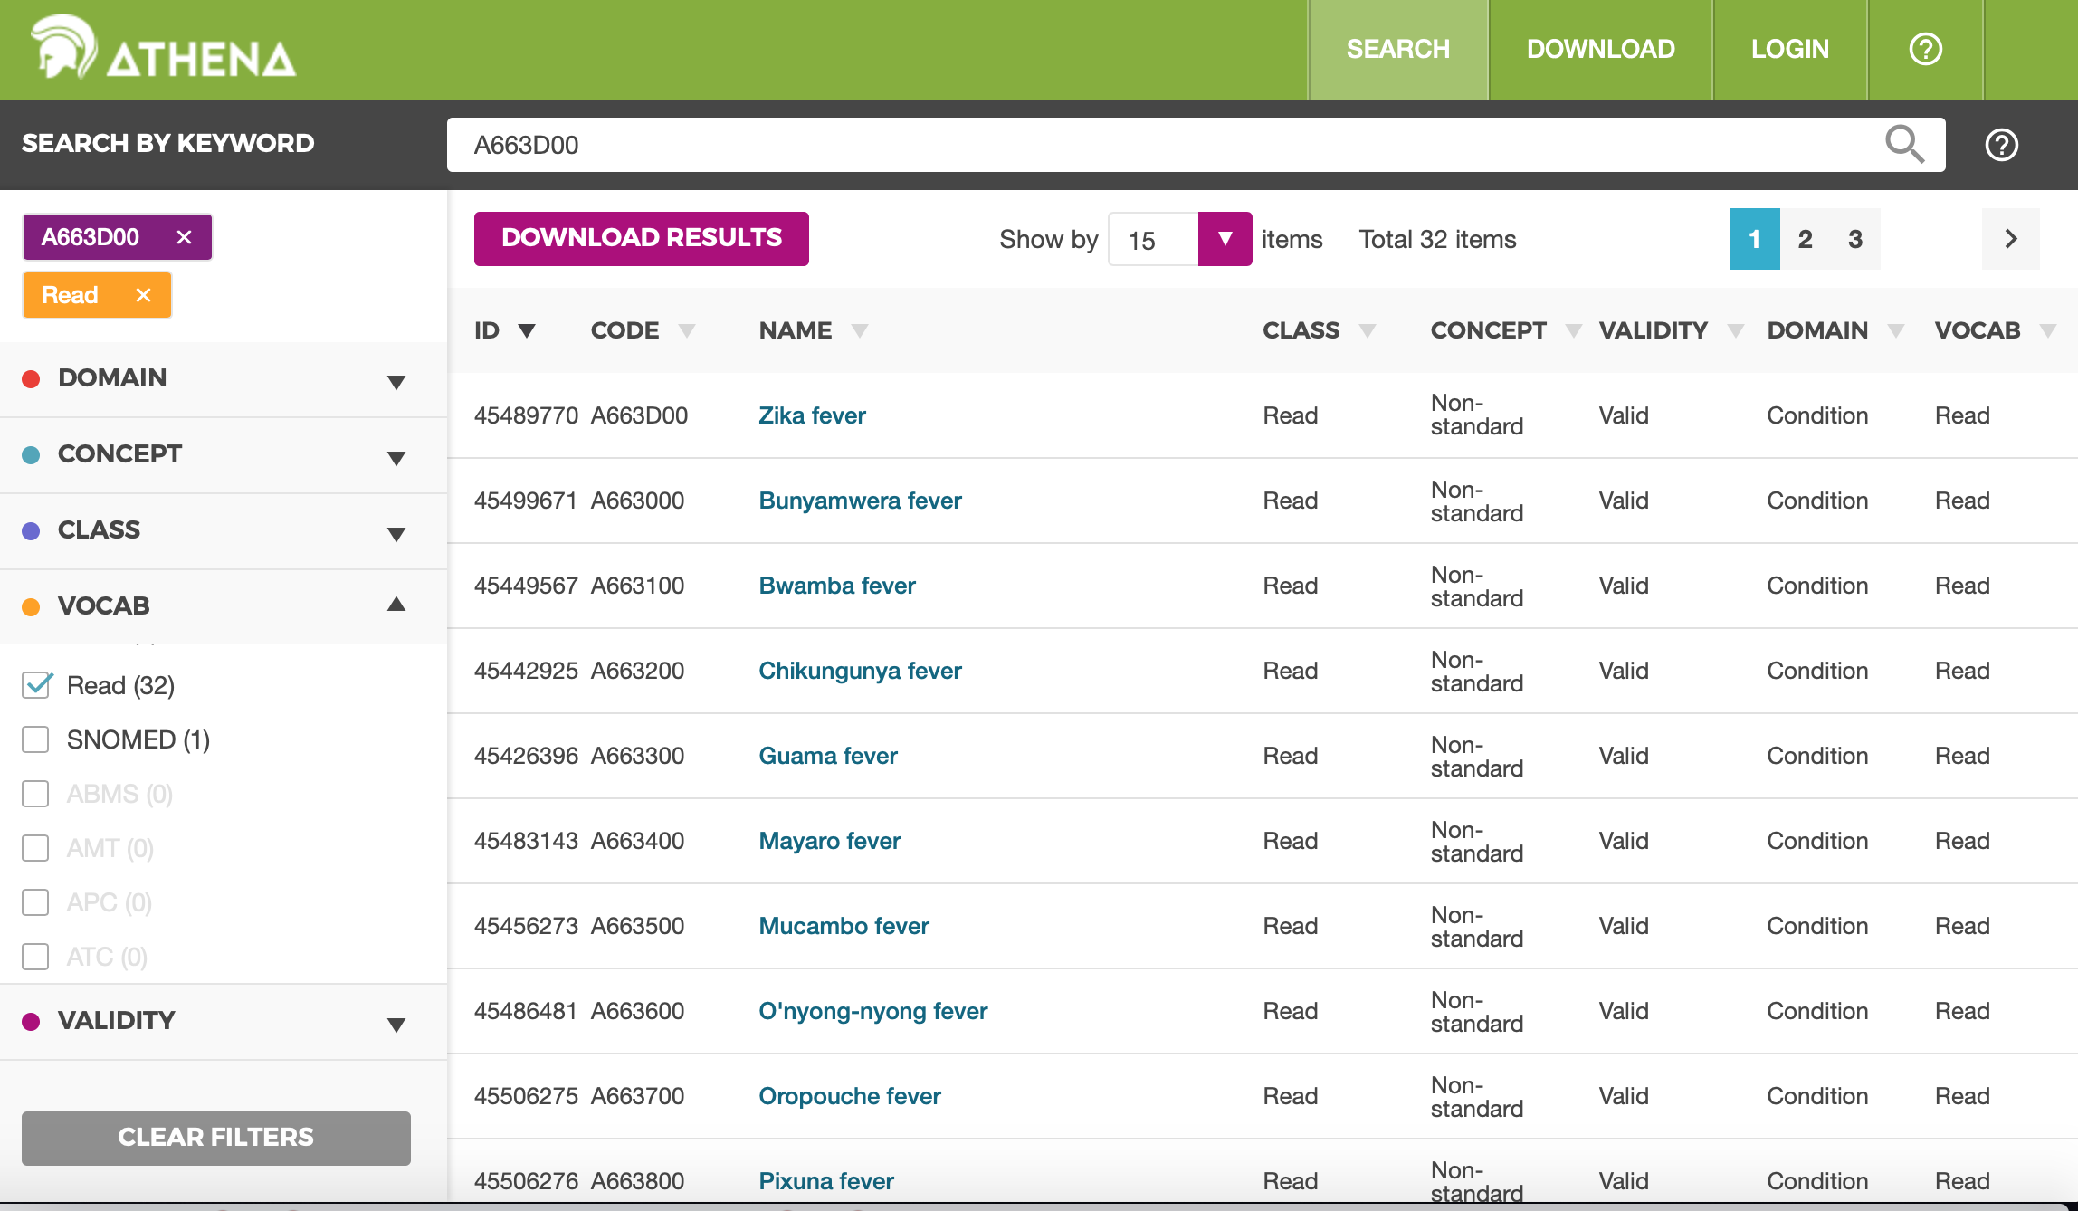

Slide 65
Source Codes Mapping – Scenario 1
Scenario
Solution
Source code is available in an OHDSI supported Vocabulary
Use using the following condition to perform the mapping:
Where <source code> = CONCEPT.concept_code and <source vocabulary> = CONCEPT.vocabulary_id
Source code | Source vocabulary | Code description | CONCEPT.concept_id
61462000 | SNOMED | Malaria | 438067
A663D00 | Read | Zika Fever | 45489770
A92.3 | ICD10CN | West Nile Virus Infection | 1404276

Slide 66
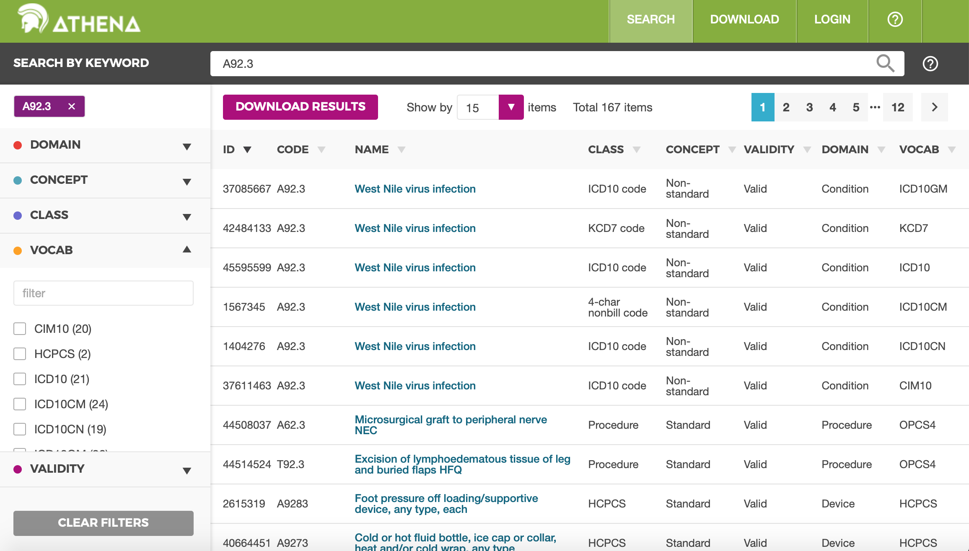

Slide 67
Source Codes Mapping – Scenario 2
Scenario
Solution
Source code is a text string
Use using the following condition to perform the mapping:
Where <source string> = CONCEPT.concept_name and <source domain> = CONCEPT.domain_id
Source string | Source domain | Source table/field | CONCEPT.concept_id
Centimeter | Unit | Unit for height measurement | 8582
Intravenous | Route | Route for drug administration | 4171047
Female | Gender | Demographics | 8532

Slide 68
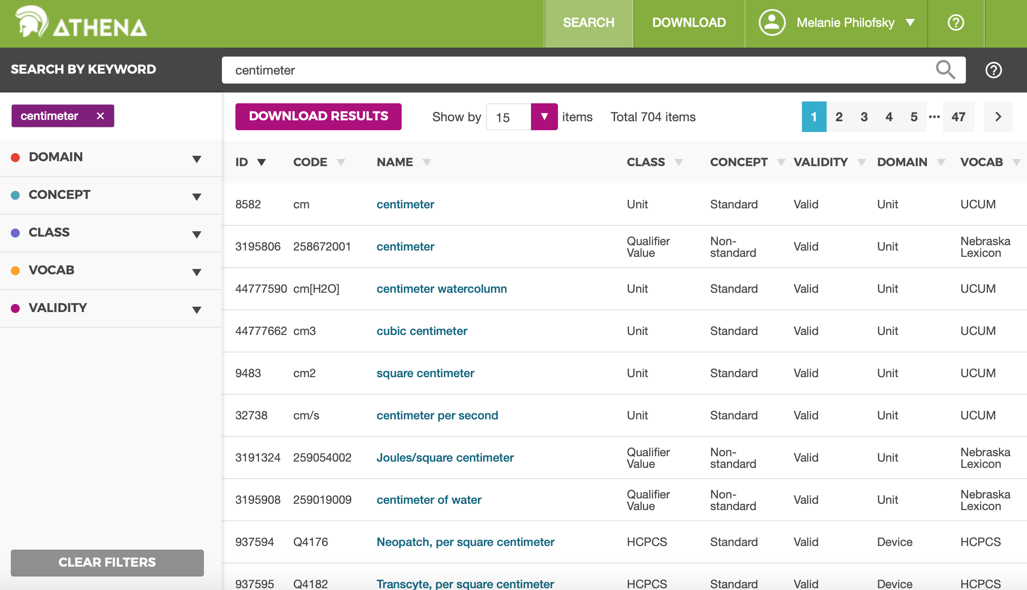

Slide 69
Source Codes Mapping – Scenario 2
Scenario
Solution
Source code is a text string
Use using the following condition to perform the mapping:
Where <source string> = CONCEPT.concept_name and <source domain> = CONCEPT.domain_id
Source string | Source domain | Source table/field | CONCEPT.concept_id
Centimeter | Unit | Unit for height measurement | 8582
Intravenous | Route | Route for drug administration | 4171047
Female | Gender | Demographics | 8532

Slide 70
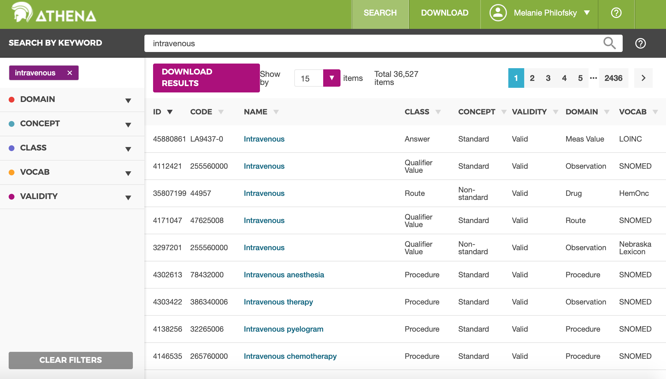

Slide 71
Source Codes Mapping – Scenario 2
Scenario
Solution
Source code is a text string
Use using the following condition to perform the mapping:
Where <source string> = CONCEPT.concept_name and <source domain> = CONCEPT.domain_id
Source string | Source domain | Source table/field | CONCEPT.concept_id
Centimeter | Unit | Unit for height measurement | 8582
Intravenous | Route | Route for drug administration | 4171047
Female | Gender | Demographics | 8532

Slide 72
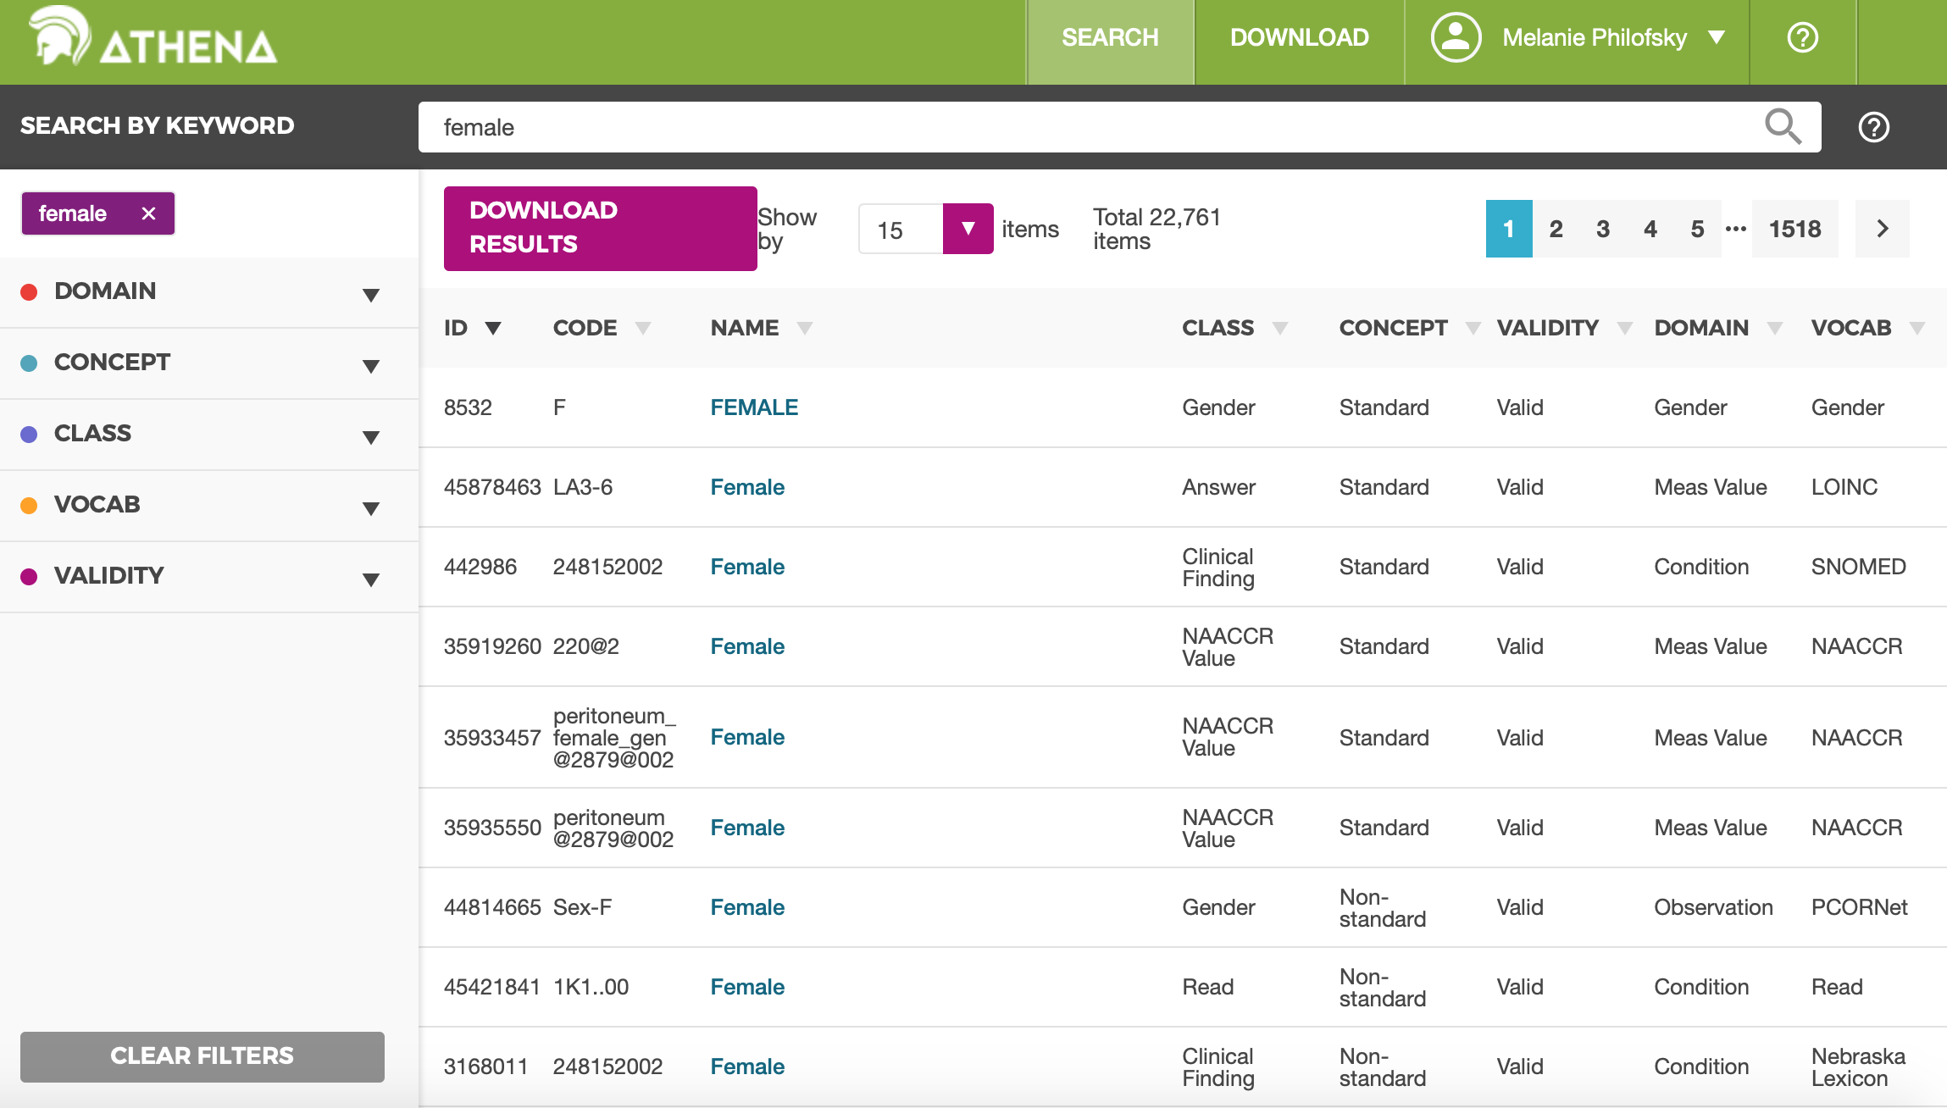

Slide 73
Source Codes Mapping – Scenario 3
Scenario
Solution
Source data does not map to standard vocabulary
Ask OHDSI to incorporate the Vocabulary
Create custom mapping
Use concept_id > 2 billion
Create a concept record for the source code
Create Concept_Relationship records to link the source concept_id to the standard concept_id
See Melanie’s poster for a full description

Slide 74
Maps to Standard Vocabulary
Step 1. Lookup the Source Concept
SELECT * FROM concept WHERE concept_code = '427.31';
CONCEPT _ID | CONCEPT_ NAME | DOMAIN _ID | VOCABULARY _ID | CONCEPT_ CLASS_ID | STANDARD_ CONCEPT | CONCEPT_ CODE
44821957 | Atrial fibrillation | Condition | ICD9CM | 5-dig billing code |  | 427.31
Step 2. Translate to Standard
SELECT * FROM concept_relationship WHERE concept_id_1 = 44821957 AND relationship_id = 'Maps to';
CONCEPT _ID_1 | CONCEPT _ID_2 | RELATIONSHIP _ID | VALID_START _DATE | VALID_END _DATE | INVALID _REASON
44821957 | 313217 | Maps to | 01-Jan-1970 | 31-Dec-2099
Step 3. Check out the standard Concept
SELECT * FROM concept WHERE concept_id = 313217;
Determines place in CDM
CONCEPT _ID | CONCEPT_ NAME | DOMAIN _ID | VOCABULARY _ID | CONCEPT_ CLASS_ID | STANDARD_ CONCEPT | CONCEPT_ CODE
313217 | Atrial fibrillation | Condition | SNOMED | Clinical Finding | S | 49436004

Slide 75
Maps to + Maps to value
In pair ‘Maps to’ + ‘Maps to value’:
Maps to points to a standard concept in Observation/ Measurement domain,
Maps to value - to a concept in any domain
Domain
Field
Maps to
Blood ethanol measurement
Measurement
Measurement_Concept_ID
Y90.0 Blood alcohol level of less than 20 mg/100 ml
ICD-10
Measurement finding within reference range
Maps to value
Condition
Value_as_a_concept_ID
Domain
Field
Maps to
History of clinical finding in subject
Observation
Observation_Concept_ID
Z88.6 Personal history of allergy to analgesic agent
ICD-9 CM
Maps to value
Analgesic allergy
Observation
Value_as_a_concept_ID

Slide 76
Other Relationships: Hierarchical and Part-of Relationships

Slide 77
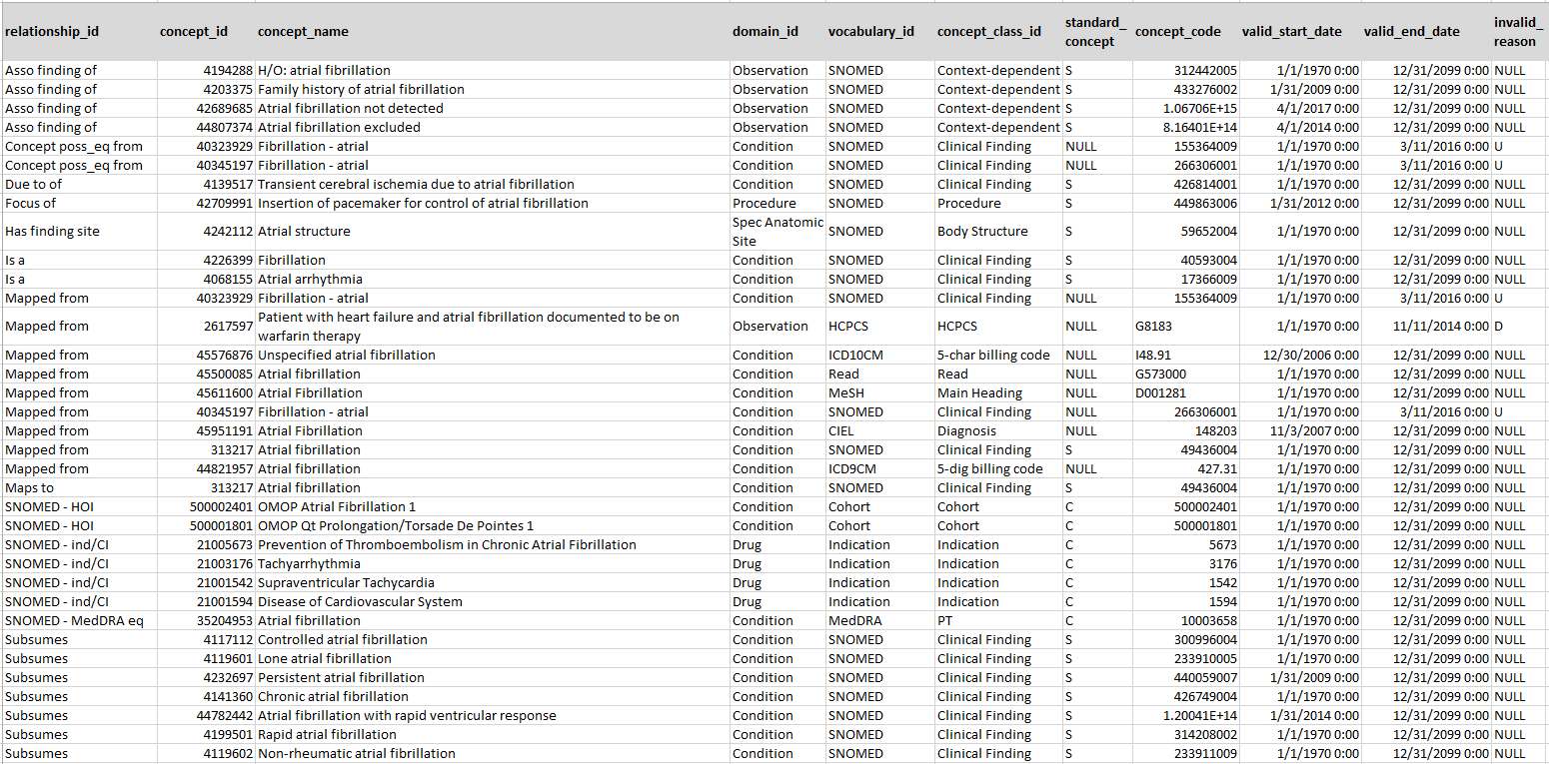
Exploring Relationships
SELECT cr.relationship_id, c.* FROM concept_relationship cr
JOIN concept c ON cr.concept_id_2 = c.concept_id
WHERE cr.concept_id_1 = 313217
Find out related concept
Ancestor concepts
Relationships are bi-directional: ‘Maps to’ and ‘Mapped from’; ‘Is a’ and ‘Subsumes’ etc.
Descendant concepts

Slide 78
Type of Relationships
‘Maps to’
‘Maps to Value’
All source vocabularies, provided by source or built by Vocab Team
Standard are mapped to themselves
Entity Relationships
‘Has direct procedure site’
‘Has method’
‘Occurs after’
Controlled well-structured ontologies: RxNorm, SNOMED, LOINC, ICD10PCS
Part-of Relationships
‘Is a’
‘CVX-RxNorm’
‘Panel Contains’
Standard and classificational terminologies (ATC, ETC, CVX, NDFRT)
Hierarchical Relationships

Slide 79
SNOMED - Transplantation of Heart
4119951 Accelerated coronary artery disease in transplanted heart
4257978 Surgical transplantation - action
Has method
Occurs before
4137127 Transplantation of heart
4217142 Heart structure
SNOMED to CPT-4 equivalent
Has direct procedure site
Follows
4309007 Heart transplant failure and rejection
2107480 Backbench standard preparation of cadaver donor heart allograft prior to transplantation, including dissection of allograft from surrounding soft tissues to prepare aorta, superior vena cava, inferior vena cava, pulmonary artery, and left atrium...
443575 Disorder of transplanted heart

Slide 80
LOINC
Individual Tests
Panel
Has system
1029919 Blood
46235479 Bilirubin fractions panel [Moles/volume] - Serum or Plasma
3020491 Glucose [Moles/volume] in Blood
Has component
Panel contains
40795740 Glucose
3005772 Bilirubin.conjugated [Moles/volume] in Serum or Plasma
Has property
1029726 Substance Concentration
3043995 Bilirubin.conjugated +indirect [Moles/volume] in Serum or Plasma
Contained in panel
36304453 German Interdisciplinary Association of Intensive Care and Emergency Care Medicine - recommended MIND protocol set
3007242 Bilirubin.indirect [Moles/volume] in Serum or Plasma

Slide 81
Hierarchy: Ancestors and Descendants

Slide 82
Ancestry Relationships: Higher-Level Relationships
5 levels of separation
Disease of the cardiovascular system
Ancestry Relationships
Ancestor
Heart disease
Cardiac arrhythmia
Supraventricular arrhythmia
Concepts
2 levels of separation
Fibrillation
Atrial arrhythmia
Concept Relationships
Atrial fibrillation
Descendant
Controlled atrial fibrillation
Persistent atrial fibrillation
Chronic atrial fibrillation
Paroxysmal atrial fibrillation
Rapid atrial fibrillation
Permanent atrial fibrillation

Slide 83
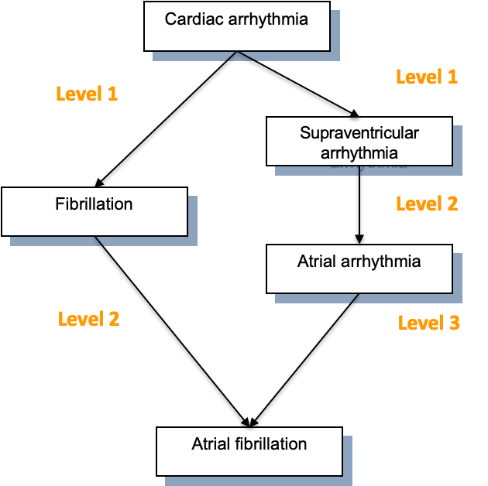
Concept Ancestor: Structure
ancestor | descendant | min_levels | max_levels | concept_name
44784217 | 44784217 | 0 | 0 | Cardiac arrhythmia
44784217 | 4086313 | 1 | 1 | Withdrawal arrhythmia
44784217 | 4185572 | 1 | 1 | Ventricular arrhythmia
44784217 | 4248028 | 1 | 1 | Supraventricular arrhythmia
44784217 | 44784234 | 1 | 1 | Cardiac arrhythmia associated with genetic disorder
44784217 | 4226399 | 1 | 1 | Fibrillation
44784217 | 4164083 | 1 | 1 | Ectopic rhythm
44784217 | 45757098 | 1 | 1 | Cardiac arrhythmia in mother complicating childbirth
44784217 | 4088986 | 1 | 1 | Atrial escape complex
44784217 | 4068155 | 2 | 2 | Atrial arrhythmia
44784217 | 4306984 | 2 | 2 | Cardiac arrest due to trauma
44784217 | 4301015 | 2 | 2 | Cardiac arrest due to pacemaker failure
44784217 | 4128968 | 2 | 2 | Circulatory arrest
44784217 | 4256374 | 2 | 2 | Cardiorespiratory arrest
44784217 | 4254116 | 2 | 5 | Tachycardia-bradycardia
44784217 | 313217 | 2 | 3 | Atrial fibrillation
Self

Slide 84
Concept Ancestor vs. Concept Relationship
SELECT ca.*, concept.concept_name FROM concept_ancestor ca
JOIN concept ON descendant_concept_id = concept_id
WHERE ancestor_concept_id = 21602728 /* Glucocorticoids */
ORDER BY min_levels_of_separation;
Glucocorticoids
ATC
Subsumes
prednisolone; systemic
ATC
ATC - RxNorm primary lateral
prednisolone
RxNorm
RxNorm ingredient of
prednisolone Oral Tablet
prednisolone 5 MG
Inverse Is a
prednisolone 5 MG Oral Tablet
Has tradename
Hydrocortisone 5 MG Oral Tablet [Cortef]
RxNorm
Notes:
Other types of rels take part

Slide 85
Condition Concepts
Classification Concepts
MedDRA
System organ class
Standard Concepts
MedDRA
High-level group terms
MedDRA
High-level terms
Top-level classification
SNOMED-CT
MedDRA
Preferred terms
Higher-level classifications
SNOMED-CT
MedDRA
Low-level terms
Low-level concepts
SNOMED-CT
Source Concepts
Source codes
ICD10
ICD10CM
Read
SNOMED
Oxmis
Ciel
MeSH
ICD9CM
Notes:
85

Slide 86
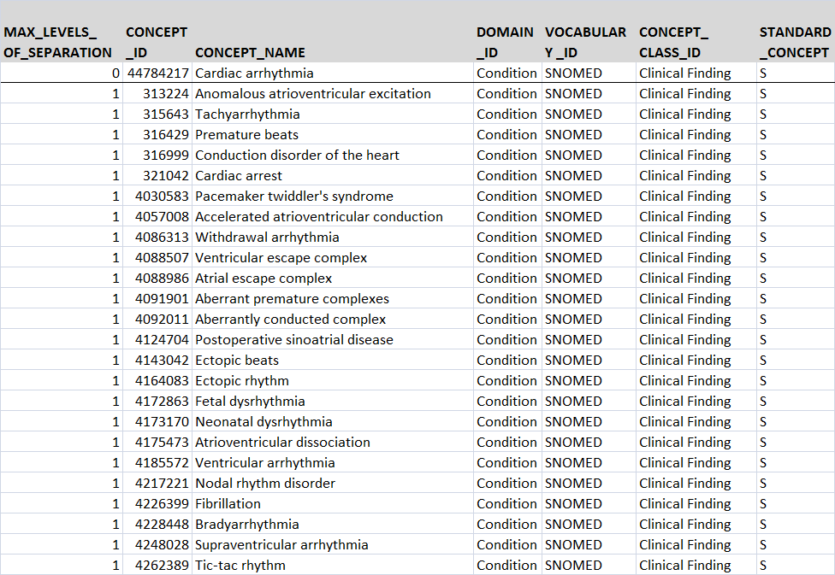
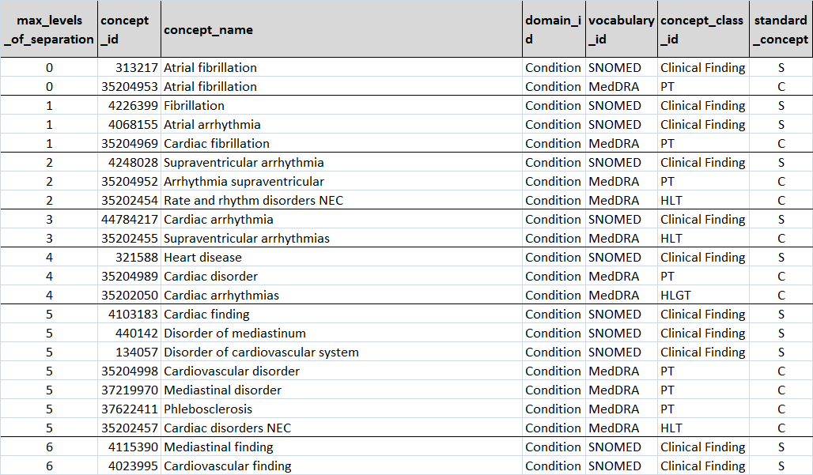
Exploring the Hierarchy
SELECT max_levels_of_separation, concept.*
FROM concept_ancestor
JOIN concept ON descendant_concept_id = concept_id
WHERE ancestor_concept_id = 44784217
/* cardiac arrhythmia */
ORDER BY max_levels_of_separation
SELECT max_levels_of_separation, concept.*
FROM concept_ancestor
JOIN concept ON ancestor_concept_id = concept_id
WHERE descendant_concept_id = 313217
/* Atrial fibrillation */
ORDER BY max_levels_of_separation

Slide 87
Drug Hierarchy
Classifications
ATC
Drug Classes
CVX
ATC
Drugs
Ingredients
RxNorm RxNorm Extension
Standard Concepts
RxNorm RxNorm Extension
Drug Forms and Components
Drug products
RxNorm RxNorm Extension
Source codes
CIEL
NDC
GPI
VA-Product
Gemscript
EU Product
DPD
HCPCS
MeSH
Multum
Oxmis
Read
Genseqno
dm+d
AMIS
BDPM
CPT4
Source Codes
Procedure Drugs

Slide 88
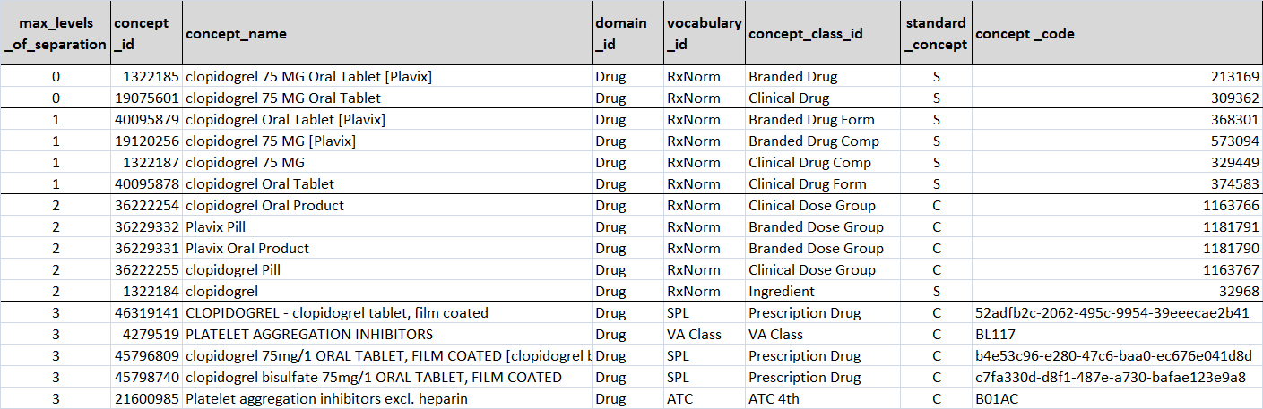
Finding Ingredients of a Drug
SELECT max_levels_of_separation, concept.*
FROM concept_ancestor
JOIN concept ON ancestor_concept_id = concept_id
WHERE descendant_concept_id = 1322185 /* clopidogrel 75 MG Oral Tablet [Plavix]*/
ORDER BY max_levels_of_separation
Clopidogrel
Drug classes

Slide 89
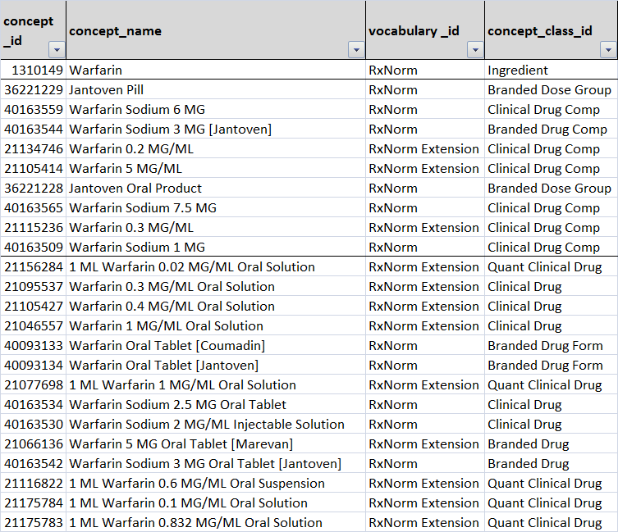
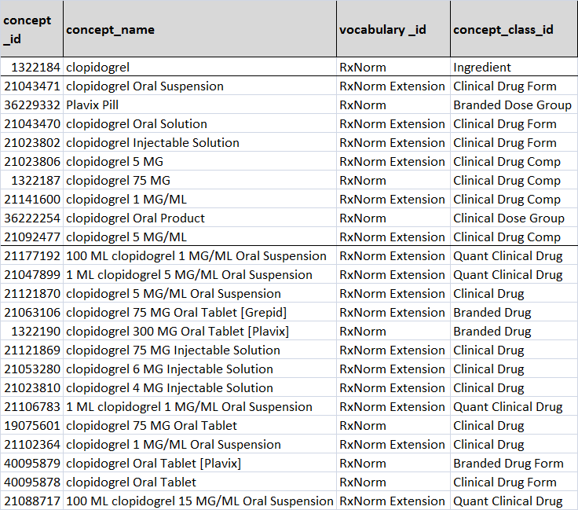
Finding Drugs with an Ingredient
SELECT max_levels_of_separation, concept.*
FROM concept_ancestor
JOIN concept ON descendant_concept_id = concept_id
WHERE ancestor_concept_id = 1310149 /* Warfarin or 1322184 Clopidogrel*/
ORDER BY max_levels_of_separation

Slide 90
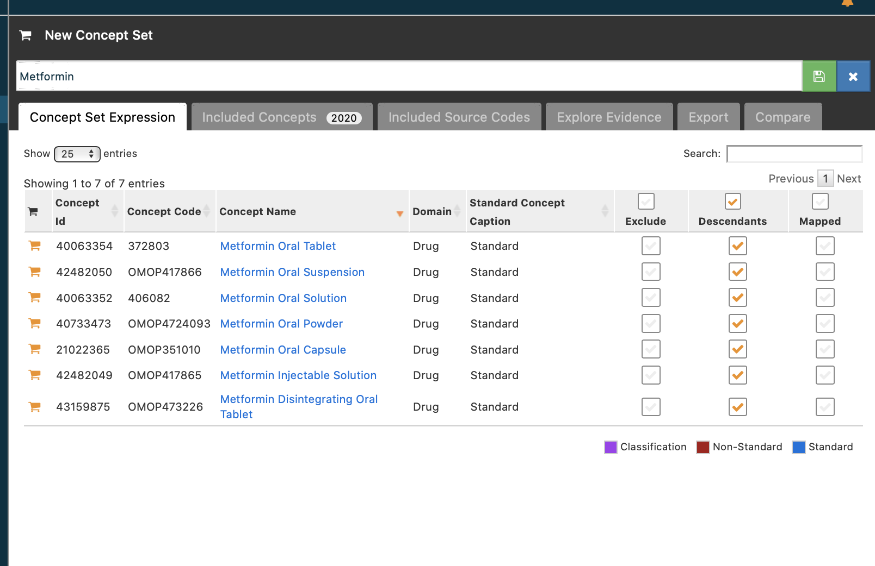
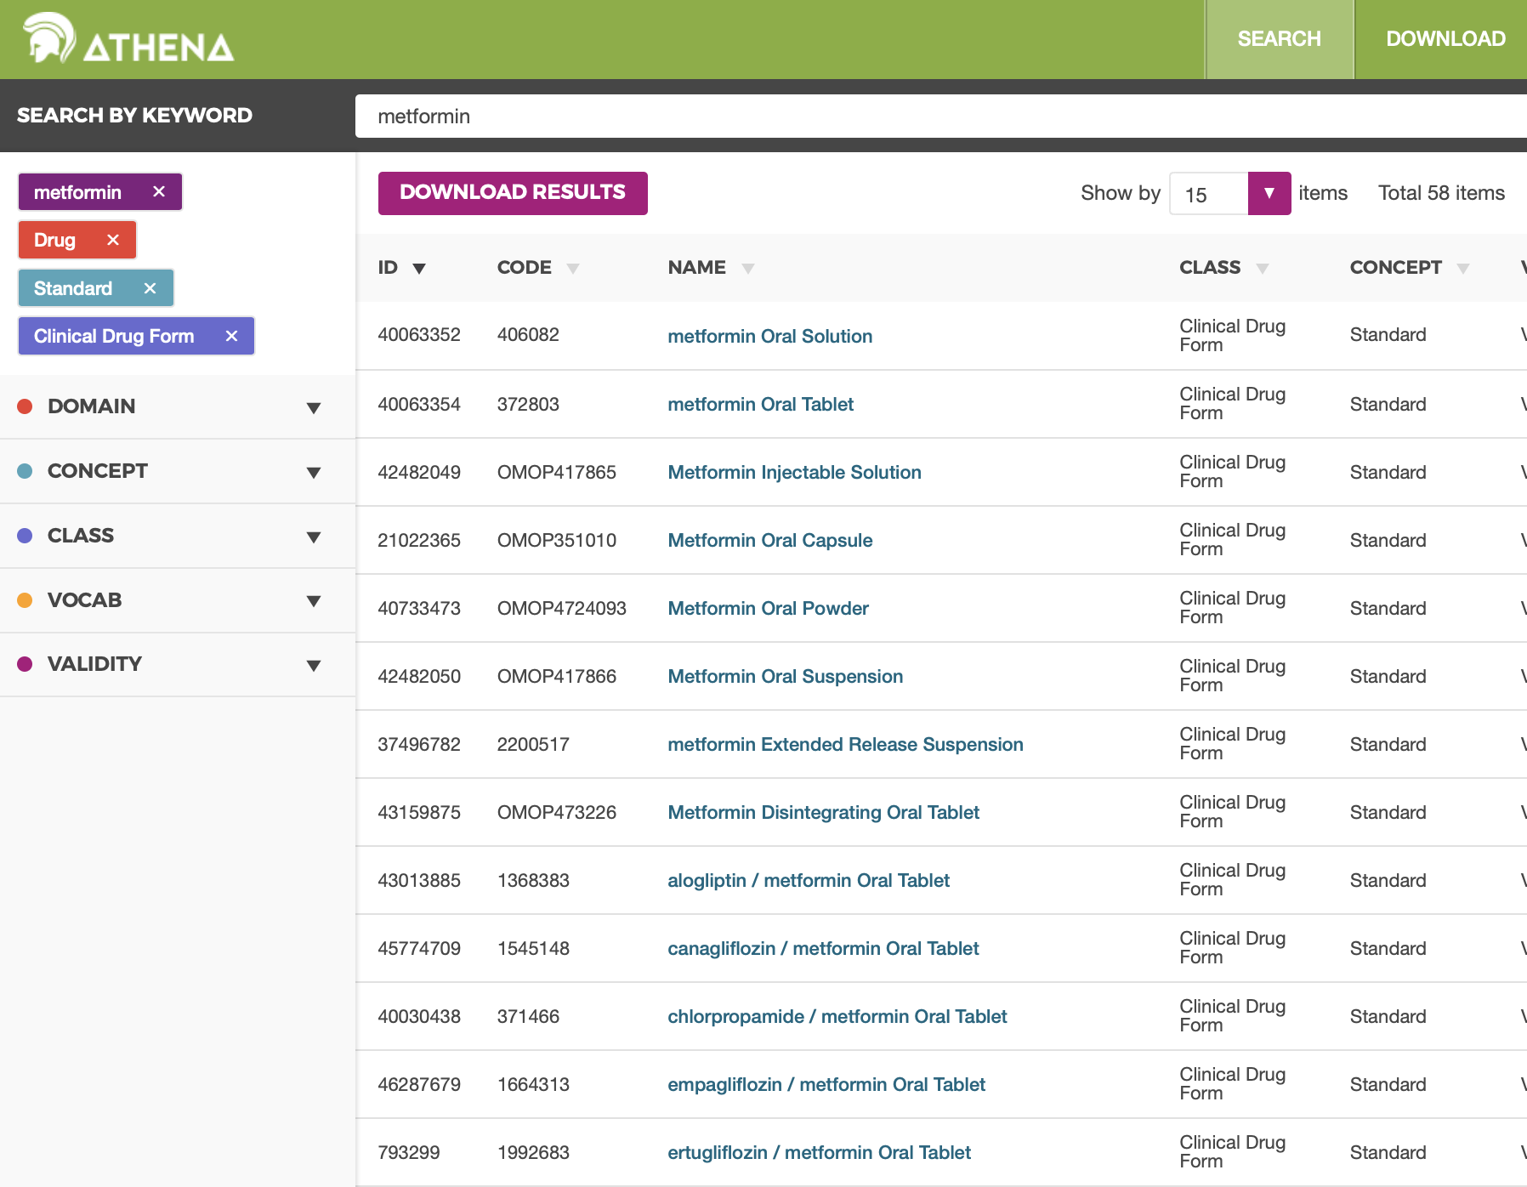
Finding Mono-Therapy Drugs
Count ingredients in DRUG_STRENGTH
Count ingredients in CONCEPT_ANCESTOR
Select descendants of Clinical Dose Form

Slide 91
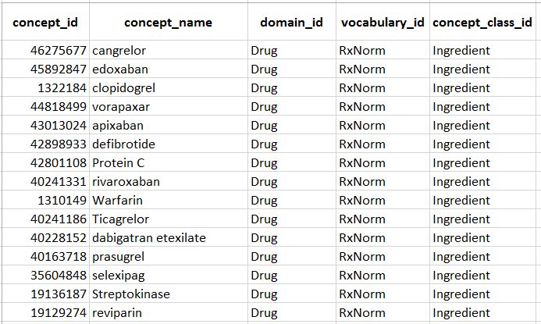
Find Members of Drug Classes
SELECT max_levels_of_separation, concept.*
FROM concept_ancestor
JOIN concept ON descendant_concept_id = concept_id
WHERE ancestor_concept_id = ﻿21600961 /* ﻿ATC Antithromboic Agent */
AND concept_class_id = ‘Ingredient'
ORDER BY max_levels_of_separation

Slide 92
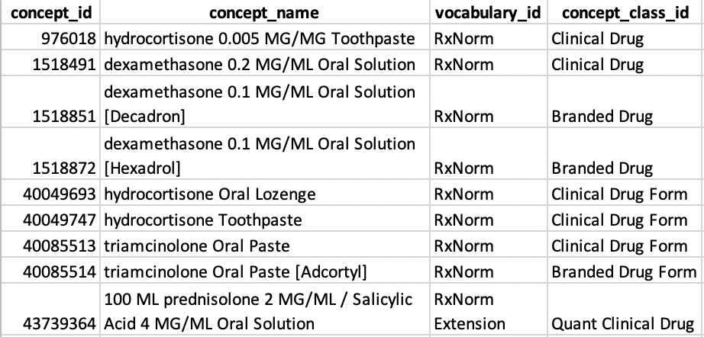
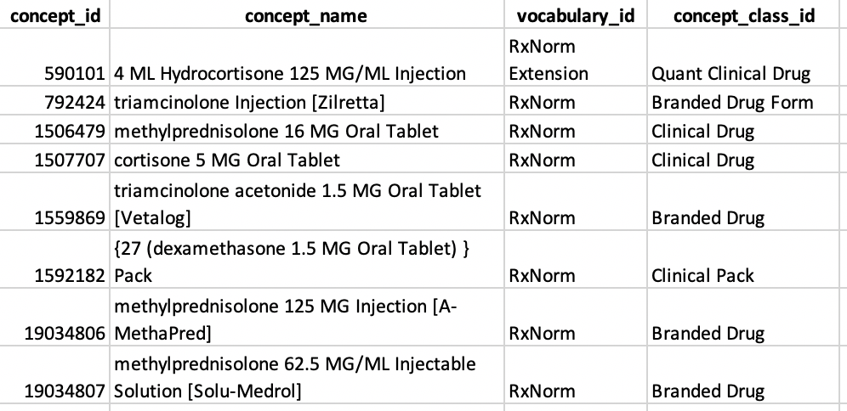
Find Members of Drug Classes
SELECT concept.*
FROM concept_ancestor
JOIN concept
ON descendant_concept_id = concept_id
WHERE ancestor_concept_id = 21600033
/* ﻿ATC Corticosteroids for local oral treatment */
SELECT concept.*
FROM concept_ancestor
JOIN concept
ON descendant_concept_id = concept_id
WHERE ancestor_concept_id = 21602722
/* ﻿ATC CORTICOSTEROIDS FOR SYSTEMIC USE */

Slide 93
Measurement Hierarchy
Joint Hierarchy
No Joint Hierarchy
Glucose Measurement
SNOMED
(less granular)
Androstanolone
Measurement
SNOMED
(Invalid)
SNOMED
SNOMED
Androstanolone | Serum or Plasma | Chemistry - non-challenge
Glucose Concentration, Test Strip Measurement
Glucose Measurement, Blood
Androstanolone | Serum or Plasma | Chemistry - challenge
LOINC
(more granular)
SNOMED
Androstanolone [Mass/volume] in Serum or Plasma --1 hour post XXX challenge
Androstanolone [Mass/volume] in Serum or Plasma --1.5 hours post XXX challenge
Androstanolone [Mass/volume] in Serum or Plasma --30 minutes post XXX challenge
Glucose [Mass/volume] in Capillary Blood
Androstanolone [Mass or Moles/volume] in Serum or Plasma
Androstanolone [Mass/volume] in Serum or Plasma
Androstanolone [Presence] in Serum or Plasma
Glucose [Moles/volume] in Serum, Plasma or Blood
LOINC

Slide 94
Procedure Hierarchy
Standard Concepts
CPT-4
HCPCS
SNOMED-CT
ICD10PCS
ICD9Proc
Source codes
ICD10CM
CPT-4
HCPCS
SNOMED
ICD10PCS
ICD9Proc
ICD10CN
KCD
ICD9CM
Source Concepts
SNOMED and ICD-9(10) Proc codes can be within each other's hierarchy
HCPCS and CPT-4 are not embedded in the SNOMED - ICD-9(10) Proc hierarchy
Notes:
94

Slide 95
Procedure Hierarchy
Mechanical ventilation
When creating a comprehensive concept set for procedures, make sure that you have at least two vocabularies in your set:
SNOMED and CPT-4 or HCPCS!
ICD9Proc Continuous invasive mechanical ventilation of unspecified duration
SNOMED Ventilatory support
CPT4 Patient receiving care in the intensive care unit (ICU) and receiving mechanical ventilation, 24 hours or less (CRIT)
CPT4 Ventilation assist and management, initiation of pressure or volume preset ventilators for assisted or controlled breathing; subsequent days
ICD10PCS Respiratory Ventilation, Greater than 96 Consecutive Hours
SNOMED Mechanically assisted spontaneous ventilation

Slide 96
OMOP CDM

Slide 97
OMOP CDM v6
Person
Standardized health system data
Standardized metadata
Observation_period
Location
CDM_source
Visit_occurrence
Metadata
Location_history
Visit_detail
Care_site
Standardized vocabularies
Condition_occurrence
Provider
Drug_exposure
Standardized derived elements
Concept
Procedure_occurrence
Vocabulary
Device_exposure
Condition_era
Domain
Standardized clinical data
Drug_era
Measurement
Dose_era
Concept_class
Note
Results Schema
Concept_relationship
Note_NLP
Cohort
Relationship
Survey_conduct
Cohort_definition
Concept_synonym
Observation
Standardized health economics
Concept_ancestor
Specimen
Cost
Source_to_concept_map
Fact_relationship
Payer_plan_period
Drug_strength

Slide 98
OMOP CDM Principles
Patient centric
Vocabulary and Data Model are standardized
Domain-oriented concepts
Accommodates data from various sources
Preserves data provenance & source data
Extendable & Evolving
Database Platform Independent

Slide 99
CDM Version Control
Working group meets once a month to discuss proposed changes to the CDM
All CDM documentation, versions, and proposals located on GitHub
https://ohdsi.github.io/CommonDataModel/index.html
Proposals tracked and discussed as GitHub issues
https://ohdsi.github.io/TheBookOfOhdsi/CommonDataModel.html
Meeting information can be found on the working group wiki page
Please contact Clair Blacketer (mblacke@its.jnj.com) for more information

Slide 100
Common Myths

Slide 101
Myth Busters
Common Doubts
Myth #1
“Loss of Data”
1
2
Myth #2
“Loss of Accuracy in Conversion”
Myth #3
“Loss of Accuracy in Vocab Mapping”
3
Myth #4
“It Takes Too Much Time”
4
Myth #5
“You Don’t Have My Use Case in OMOP”
5
Myth #6
“I Have to Learn New Medical Terminology”
6

Slide 102

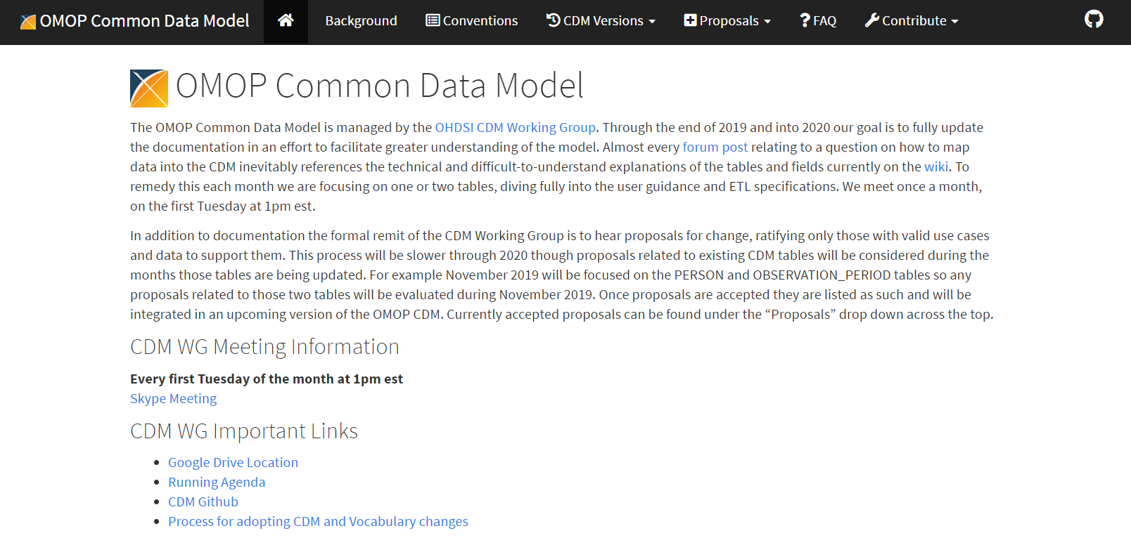
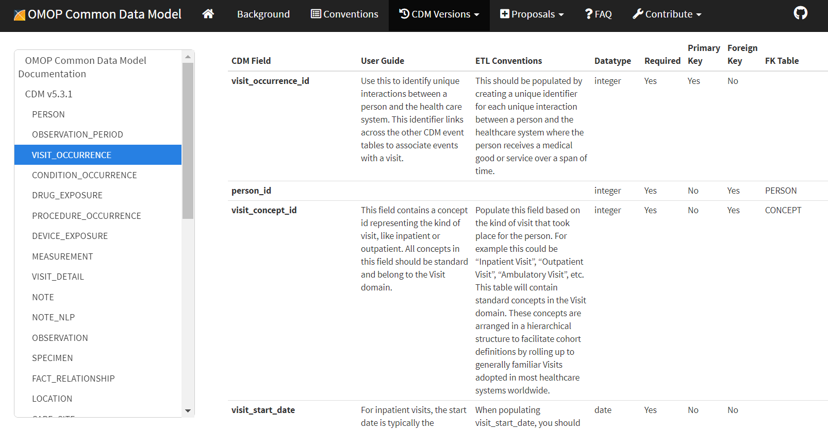
OHDSI Standards
Myth #1
“Loss of Data”
Myth
Resources
Some believe that converting to a CDM will result in “losing” data because it does not map to the standard. There is skepticism about why the total number of patients in the source data does not match the CDM data.
Online documentation: https://ohdsi.github.io/CommonDataModel/
Truth
Source data is preserved within the CDM, even if no standard mapping exist
OHDSI has standard conventions that enforce rules data must follow, including addressing:
Patients without transactions
Cleaning dirty data
Patient IDs reused
And more

Slide 103
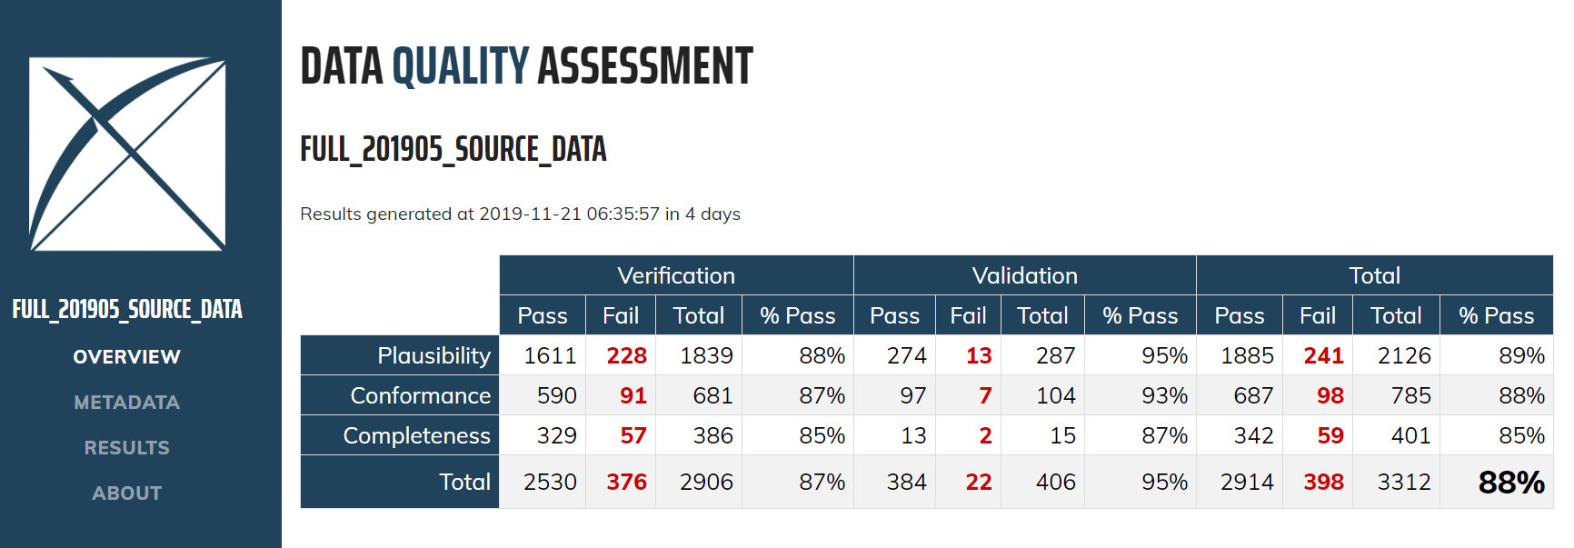
Data Quality
Myth #1
“Loss of Data”
Myth
Resources
Some believe that converting to a CDM will result in “losing” data because it does not map to the standard. There is skepticism about why the total number of patients in the source data does not match the CDM data.
Truth
After converting data from source to OMOP, have standard quality control including:
OHDSI Data Quality Dashboard
Achilles checks

Slide 104
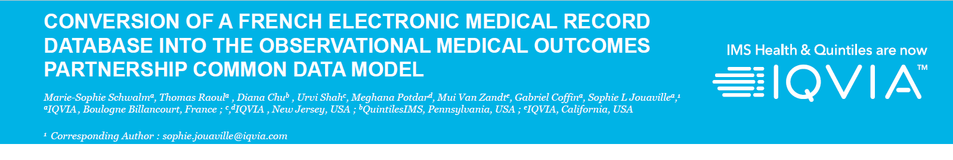
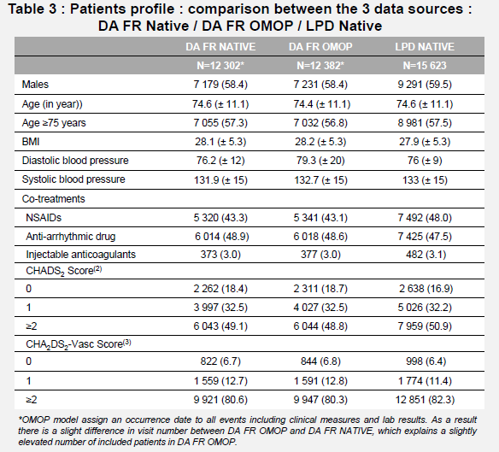
Retaining the Accuracy of Source Data
Myth #2
“Loss of Accuracy in Conversion”
Myth
Examples
Some believe that using OMOP standards can degrade the accuracy of the data. There could be issues in the conversions ability to accurately reflect a data set.
Truth
Validation studies have found minimal differences in the source to OMOP data
DA France / LPD France validation study found consistency between native and OMOP data sets

Slide 105
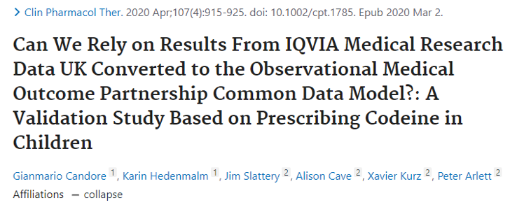
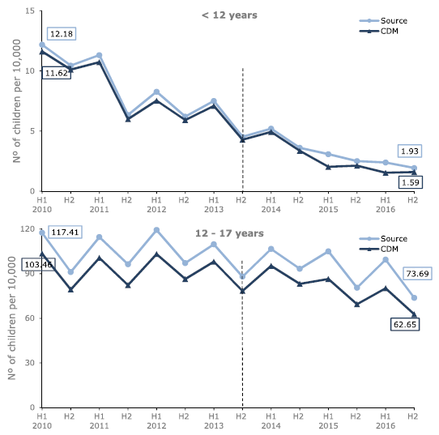
Evaluating the Accuracy of Vocabulary Mapping
Myth #3
“Loss of Accuracy in Vocab Mapping”
Myth
Examples
Some believe that using OMOP vocabulary mappings are incorrect. There could be issues in the preservation of source information as it is translated to standard concepts.
Truth
Validation studies have found minimal differences in the source to OMOP data
EMA Validation study of IQVIA IMRD UK found consistency between source and OMOP CDM data
Figure 1-2: Six-monthly prevalence (per 10,000) of codeine prescribing for pain in 0–17 years

Slide 106



OMOP Conversion Overview
Myth #4
“It Takes Too Much Time”
Myth
Examples
Taking data from source format to OMOP common data model is tedious and time consuming.
Truth
It’s true, it takes time to convert data into the OMOP CDM.
We spend time cleaning the data and removing data that cannot contribute to analytical use cases.
We push down common business rules into the ETL process.
Studies execute faster due to standardization and common model.

Slide 107




OMOP Evolves to Meet Analytical Needs
Myth #5
“You Don’t Have My Use Case in OMOP”
Myth
Examples
OMOP is not good enough for my analytical use case or covers the therapeutic area that I want to study.
Truth
It’s true, OMOP was not built for every use case, but it has evolved over the years to support a variety of analytic needs.
If you have a use case, bring it up on the CDM working group. If there’s enough of a common need, OMOP will evolve to support additional use cases.

Slide 108


OMOP Oncology Extension
Myth #5
“You Don’t Have My Use Case in OMOP”
Myth
Examples
OMOP cannot support oncology data.
Truth
OMOP Oncology experts created an Oncology working group.
The Oncology working group designed an Oncology extension to house oncology-specific information in the OMOP CDM.
https://ohdsi.github.io/CommonDataModel/oncology.html

Slide 109

OMOP Vocabulary Hierarchy
Myth #6
“I Have to Learn New Medical Terms”
Myth
Examples
OMOP is forcing me to speak in SNOMED, RxNorm and LOINC codes.
Ancestry Relationships
Truth
OMOP CDM preserves the source codes from the native data and creates a map to a standard concept that is interoperable across all data assets
You can always start with source codes (e.g. ICD-9/ICD-10) and use the maps to relationships to find standards.
The hierarchy structure in the standard vocabulary is easily navigated using ancestors and descendants.

Slide 110
Common Issues

Slide 111

Common OMOP CDM issues
Non-standard Vocabulary
Codes mapped to OMOP vocabulary aren’t mapped to a ‘Standard’
Multiple Input on Records
Some records will contain multiple coding systems and text. A hierarchy must be selected to avoid duplicate records
Non-Clinical Events
Due to text options in EHR Data, many options are not clinical events (e.g. ‘Tuesday’ or ‘XXYZ’). These records will be scrubbed to ensure quality of data converted to OMOP.
Multiple records for one concept mapping
Picking one of the multiple standard vocabulary mapping to create the OMOP CDM record instead of one record per mapping
Abnormal values
Unconventional values in data asset (i.e. Negative or 0 as value_as_number)
Incorrect logic -
Observation_Period Observation_Period table populated incorrectly. Observation period does not cover the entire period of time where events are recorded for a person
Wrong type_concept_id
Use of the wrong type_concept_id or misunderstanding the definition of this field
Missing CDM tables
OMOP CDM tables missing due to misunderstanding on how to populate the table.
Incorrect logic - Visit_Occurrence
Visit_Occurrence table populated incorrectly

Slide 112
No Standard Vocabulary
Issue
Solution
Text fields
Duplicate and unclear values in source concept names
Proprietary coding system
No OMOP standard vocabulary mapping available even though vocabulary is in Athena
Own Mapping Team
Mapped translated terms to OMOP standard vocabulary
OMOP Vocabulary Team
Prioritized terms for mapping
Verify translated terms
Confirm translation with medical team
Downloaded latest vocabularies

Slide 113

Wrong Type_Concept_IDs
Issue
Solution
Used their internal coding systems for type_concept_ids
Wrong meanings were assigned to type_concept_ids
Standardize all type_concept_ids in each table
Find correct concept_id using ATHENA

Slide 114
Thank you

Slide 115

Abnormal Values
Issue
Solution
Negative, 0, null values or decimals in measurement and drug_exposure domain
Check source data for related domains and check if it’s reasonable from medical perspective

Slide 116
Missing CDM Tables
Issue
Solution
Incomplete OMOP CDM tables
Potential Missing Tables:
Procedure_occurrence
Device_exposure
Visit_detail
Observation
Payer_plan_period
Dose_era
Location
Cost
Check source data for related domains
Provide mapping rules from source data to OMOP CDM, and populate the missing tables

